Slide 1
Adding imagery to your writing

Slide 2
Why is imagery important?
Creating “pictures” in the head of a reader is a powerful technique that engages and entertains.
“Showing” rather than “telling” allows the reader to use their imagination.
Ex. of “telling” = “Jim was tired.”
Ex. of “showing”= “Jim’s eyes had grown glazed, and had circles, grey as concrete, around them.”

Slide 3
How to add imagery:
1. Appeal to the senses
describe tastes/sounds/sights/feelings/smells
Ex. "In our kitchen, he would make his orange juice (squeezed on one of those ribbed glass sombreros and then poured off through a strainer) and grab a bite of toast (the toaster a simple tin box, a kind of little hut with a slit and slanted sides, that rested over a gas burner and browned one side of the bread, in stripes, one at a time), and then he would dash, so hurriedly that his necktie flew back over his shoulder, down through our yard, past the grapevines hung with buzzing Japanese-beetle traps, to the yellow brick building, with its tall smokestack and wide playing fields, where he taught." -John Updike, "My Father on the Verge of Disgrace"

Slide 4
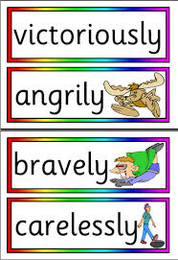
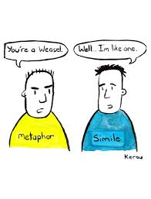
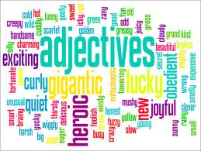
How to add imagery:
2. use descriptive words or devices:
Adjectives and adverbs
Similes and metaphors

Slide 5
Adjectives tell you about:
What kind:
Ex. Big, blue, round, short, spectacular
How many:
Ex. A, ten, lots, some, several, one
Which ones:
Ex. That, those, his, hers, their, your, its, the
One, big, robust pig ate those rotten beets.

Slide 6
Adverbs
Describe, or modify, VERBS, ADJECTIVES, or other ADVERBS.
Adverbs tell you:
How- secretly, quickly, carefully
When- then, later, finally
Where- nearby, underground, here
To what extent- often, deep, never

Slide 7
Similes
What= a figure of speech that directly compares two different things, usually by employing the words “like” or “as”
Why= to explain, to express emotion, to make writing more vivid and entertaining
Example=
My passion is as mustard strong; I sit all sober sad; Drunk as a piper all day long, Or like a March-hare mad.

Slide 8
Metaphors
What= a word or phrase where an object or idea is used in place of another to suggest a likeness.
A metaphor does not use “like” or “as” as a part of the comparison.
A metaphor encourages the reader to draw a comparison between two seemingly unrelated things
Examples:
“Drowning in money”
“One Direction is chicken soup for my soul.”

Slide 9
Do the practice worksheet, yo.

