Slide 1
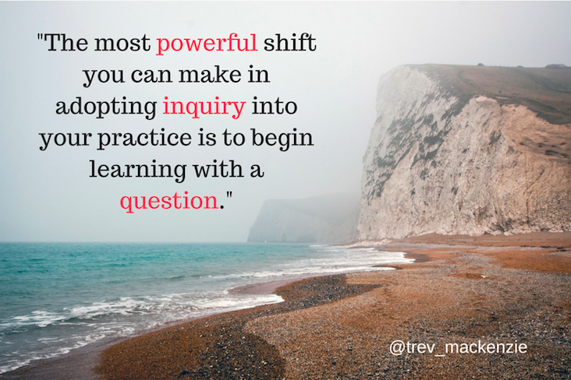

Slide 2
Asking Essential Questions Activity
How to turn your topic into a question

Slide 3
Essential Question Process
Choose a question focus
Produce questions
Look at closed vs open-ended questions
Flip questions
Prioritize questions
Select your essential question

Slide 4
Step 1: Recall your Area of Focus from way back in Sept.
For example: The world’s wetlands are in danger.

Slide 5
Step 2: Ask and Share Questions
-Ask and list as many questions as possible about your focus area.
Ex. What is a wetland? How do wetlands form? -List questions as they were posed, don’t stop to judge, edit or revise questions! -Flip any statements into questions

Slide 6
5 minutes to gather questions

Slide 7
Step 3: Closed vs Open Questions
Open-Ended vs. Closed-Ended Questions

Slide 9
Open-Ended Questions: Encourages more explanation and deeper thinking. Which one, what if, how, should, why. Ex: Who was impacted most negatively when BC joined confederation?
Close-Ended Questions: Can be answered with a yes or no, or a simple response. Ex: When did BC join confederation?

Slide 10
3 minutes to
categorize questions

Slide 11
Step 4: Flip Questions
Open-Ended to Closed-Ended

Slide 12
5 minutes to
flip questions

Slide 13
Step 5: Prioritize Questions
Which questions will lead you towards deep learning and critical thinking?

Slide 14
2 minutes to prioritize questions

Slide 15
Step 6: Select your essential question

Slide 16
Reflection:
Going through this process will help you discover an area of specific interest that you can then “dive into”.
The goal is for you to come up with a question that is MEANINGFUL for your interests.
How does the idea of coming up with your own questions to answer make you feel?

Slide 17
Here are some sample inquiry questions:
1. In what ways does art influence society? 2. How did Louis Riel’s actions shape the future of Canada? 3. To what extent does nutrition impact the performance of an athlete? 4. How can different pottery techniques be used to create unique pieces of art? 5. When is it necessary for a country to limit the individual freedoms of its citizens?

