Slide 1
Assessing Writing
For each of the following sentences identify grammatical and stylistic issues.

Slide 2
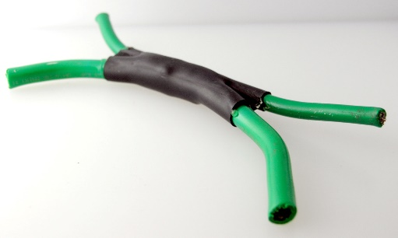
Ila enjoys cooking, it is too hot in the kitchen.
This is a comma splice. You cannot attach 2 independent clauses together with a comma.
How can we fix this?
Use a CONJUNCTION! https://www.youtube.com/watch?v=ODGA7ssL-6g

Slide 3
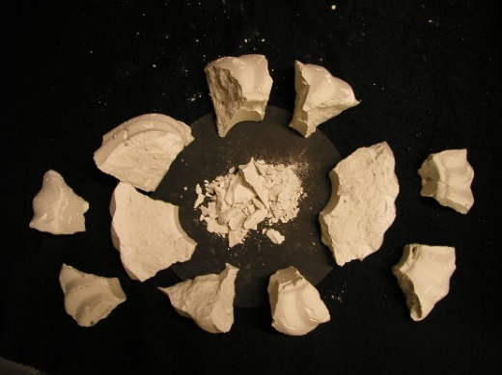
Even though it is really cold outside.
This is a sentence fragment. It is a dependent clause with a subject and predicate, but it cannot stand alone as a complete thought.
How can we fix this?
Either get rid of the subordinate words “even though”, or add an independent clause to complete the thought.
Ex. Even thought it is really cold outside, we have decided to ski today.

Slide 4
Grace and Matthew went to class and they sat in the back seats and they took part in a stimulating discussion about grammar and writing.
Grammatically there is nothing wrong with this, but stylistically it is flawed. There are too many “ands”.
How could we fix this?
Break it up into multiple sentences.
Ex. Grace and Matthew went to class. They sat in the back seats and took part in a stimulating discussion about grammar and writing.
Change some of the wording.
Ex. Grace and Matthew went to class where they sat in the backs seats and took part in a stimulating discussion about grammar and writing.

Slide 5
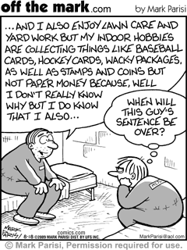
Helping people in the world makes you more social and more friendly the more people you talk to the more social you are.
This is a run on sentence that has a grammatical issue…2 independent clauses are stuck together without a conjunction.
How do we fix this?
Either break it into 2 sentences, or add a conjunction after the word “friendly”

