Slide 1
The thesis Statement

Slide 2
The Thesis Statement
Thesis Statement: The thesis statement is the central, controlling idea of a piece of writing. It is like a promise that tells the reader what you will discuss

Slide 3
In a thesis statement you should mention the TOPIC of the essay AND the POINTS you will discuss.
EX. The Ramones is a legendary rock band (The general topic) because of their relentless world wide touring and their catchy songs that have an anti-establishment edge. (points to discuss)

Slide 4
Characteristics of an effective thesis statement:
1. Narrow the topic to something that is managable enough for the time that is given. Ex. "The BYU campus has a multitude of interesting features which make it attractive."
This is TOO broad! You have promised to talk about MANY things.
A better statement would read "The BYU campus has architectural and artistic features which make it attractive."

Slide 5
Make sure your thesis is based on logic and reason. (Remember to use your critical thinking!)
An effective thesis makes an assertion, but must not be based on prejudice.
Ex. “Boys, and men, who wear their ball caps backwards are losers." This is based on prejudice and cannot be defended with logic and reason.

Slide 6
Presenting a fact as your thesis limits your ability to be creative and interesting.
Your thesis must be able to be defended with logic and reason rather than stating obvious facts.
"The Reynolds school is made of cinder blocks and bricks." This is an obvious fact and is not interesting!
To make this better make an assertion.
"Because the Reynolds school is made of cinder blocks and bricks it is particularly at risk in the event of an earthquake or Tsunami."

Slide 7
3. There must be unity. The ideas mentioned in your thesis must be connected.
Ex. Of a thesis that has ideas that are NOT connected:
The Australian Shepherd is a wonderful dog because they are easy to train, eat carrots, and do not suit a household with kids.
Here is a thesis statement that has connected ideas:
The Australian Shepherd is a wonderful dog because they are easy to train, are protective of their owners, and are low maintenance.

Slide 8
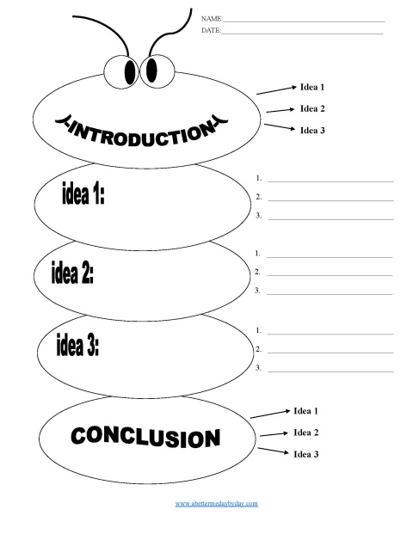
4. It indicates structure.
A strong thesis statement predicts the order that the essay will follow. By doing this, you will guide your writing AND the reader will be able to easily follow your argument(s).
Ex. The Australian Shepherd is a wonderful dog because they are easy to train, are protective of their owners, and are low maintenance.
Body Paragraph 1
Body paragraph 2
Body paragraph 3

Slide 9
So…
1. Narrow the topic: *ex. The topic of "Food" can be narrowed to Italian food, which can be narrowed to Pizza, which can be narrowed to Ali Baba's pizza.
2. Make an assertion. *ex. Ali Baba's pizza is the best pizza in Victoria.
3. Create your arguments. *reasonable prices, variety of flavours, they don't skimp on toppings.
Thesis statement: "Because of their reasonable prices, the variety of flavours offered, and the plethora of toppings piled high, Ali Baba's pizza is the best in town."

Slide 10
Practice time:
Let’s say that you had to write a multi-paragraph piece on how characters in “Edward Scissorhands” are impacted by injustice.
Main idea= characters are impacted by injustice
Supporting points= Edward, Kim, Jim
Thesis= In “Edward Scissorhands”, the characters of Edward Kim, and Jim are impacted by injustice.

Slide 11
Practice time:
Let’s say that you had to write a multi-paragraph piece on how dogs are better than cats.
Main idea= dogs are better than cats
Supporting points= ________,_________,________
Thesis= Because of ________,_________,and ________, dogs are better than cats

Slide 12
Practice time:
Let’s say that you had to write a multi-paragraph piece on why Canada is OR is not a good place to live.
Main idea= ________________________________
Supporting points= ________,_________,________
Thesis= Because of ________,_________,and ________, ________________________________.

