Slide 1
Sentences!

Slide 2
Simple Sentences:
ONE independent clause. Examples include:
“I am balding.”
“The really big, hairy, stinky, bearded, and bespectacled gentleman tipped his hat.”

Slide 3
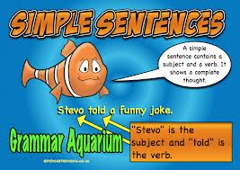

Slide 4
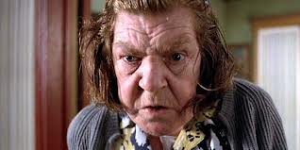
Compound Sentences:
Two or more independent clauses joined together with a conjunction.
Examples include:
“I am hungry, but you are thirsty.”
“He said he is Owen’s friend, but Owen doesn’t have any friends.”

Slide 6
Complex Sentences:
One independent clause and one dependent clause.
Examples include:
“While the sun shone, the boys played soccer.”
“After they finished studying, Juan and Maria went to the movies.”
“Juan and Maria went to the movies after they finished studying.”

Slide 7
Compound-complex Sentences:
One dependent clause and two, or more, independent clauses joined with a conjunction. Examples include:
“While the sun shone, the boys played soccer, and the girls played volleyball.”
“Even though I enjoy it, I find Math difficult, so I need to study hard.”

Slide 8
Try this!
Try to make a SIMPLE sentence that has at least 12 words.
Create a COMPOUND sentence that uses the conjunction “BECAUSE” and talks about Cops for Cancer.
Create a complex sentence that has Reynolds school mentioned in it.
Create a compound complex sentence that uses the following words: mime, roadrash, steel, hiccup, flavour.

