Slide 1
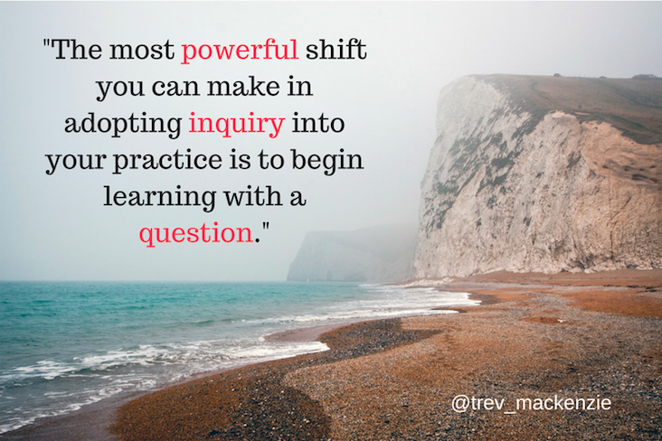

Slide 2
Asking Essential Questions Activity
How to turn your topic into a question

Slide 3
The Right Question Technique by Dan Rothstein &
Luz Santana

Slide 4
Essential Question Process
Choose a question focus
Produce questions
Look at closed vs open-ended questions
Flip questions
Prioritize questions
Select your essential question

Slide 5
Step 1: Choose your Question Focus
-With your partner, pick a topic from one of your subject areas that you are currently learning in.
For example: The solar system is part of the Milky Way, which is one of billions of galaxies. (Grade 9 Science)
Another example: The Pythagorean Theorem is used to establish the lengths of sides of triangles.

Slide 6
2 minutes to choose your focus

Slide 7
Step 2: Ask and Share Questions
-Ask and list as many questions as possible about your focus area.
Ex. What is a galaxy? How can we measure a galaxy? -List questions as they were posed, don’t stop to judge, edit or revise questions! -Flip any statements into questions

Slide 8
5 minutes to gather questions

Slide 9
Step 3: Closed vs Open Questions
Open-Ended vs. Closed-Ended Questions

Slide 11
Open-Ended Questions: Encourages more explanation and deeper thinking. Which one, what if, how, should, why. Ex: Who was impacted most negatively when BC joined confederation?
Close-Ended Questions: Can be answered with a yes or no, or a simple one word response. Ex: When did BC join confederation?

Slide 12
3 minutes to
categorize questions

Slide 13
Step 4: Flip Questions
Open-Ended to Closed-Ended

Slide 14
5 minutes to
flip questions

Slide 15
Step 5: Prioritize Questions
Which questions will lead you towards deep learning and critical thinking?

Slide 16
3 minutes to prioritize questions

Slide 17
Step 6: Select your essential question

Slide 18
Reflect

Slide 19
Reflection:
Going through this process will help you discover an area of specific interest that you can then “dive into”.
The goal is for you to come up with a question that is MEANINGFUL for your interests.
How does the idea of coming up with your own questions to answer make you feel?

Slide 20
Here is the question that I came up with using this process for our story telling unit:
How can the perspective a story is told in change the interpretation of that same story?
With your partner, discuss ways you could try to answer the question.

