Slide 1
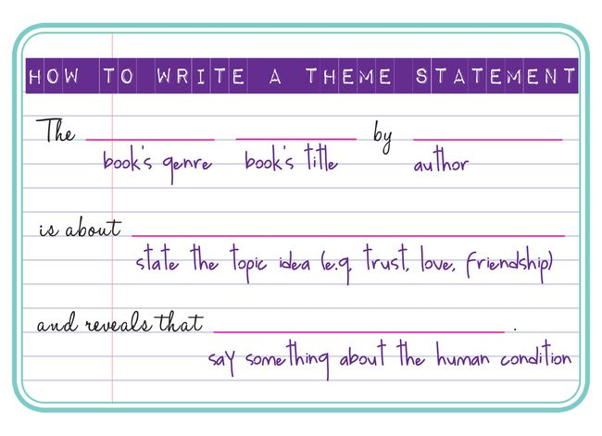
Creating a theme statement

Slide 2
A successful theme statement must be general enough to capture the overall meaning of the work, but specific enough so that it conveys your unique interpretation.
In a sense, every literary work makes a statement or has a point. When you create a theme statement, you're substituting a single sentence for the entire piece of writing.
You may have to simplify the meaning somewhat to get it into a single sentence, but nevertheless, your theme statement itself should make a point.

Slide 3
The theme statement should describe the general meaning of the work, not the specific events, actions, or characters.
“Luke defeats Darth Vader" is plot summary.
Instead of describing what the characters do, discuss what they represent ("Good defeats evil"). This can be a first step toward making your theme statement.
Often the theme statement takes the form of a moral or a judgment. Ex."We cannot defeat an external evil until we acknowledge our own dark side."

Slide 4
Which is a theme statement?
1. Love.
2. Mrs. Farquar learns that British people can't dance.
3. If the people in power do not take care of those without power, then society will fall apart.
1= a general topic, 2= plot summary, 3= THEME STATEMENT!

Slide 5
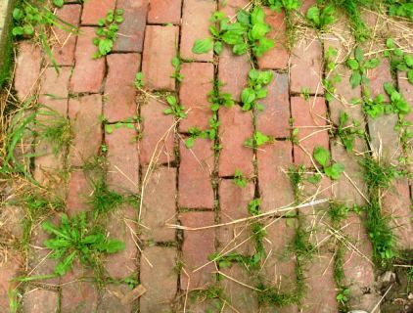
Creating a Theme Statement in 3 Steps
Step 1= Select an important TOPIC included in the writing. (Topic ideas include: freedom, love, trust, death, forgiveness, rebellion, sacrifice…)
Ex. The Weed includes: tough decisions, rebellion, sacrifice, loyalty…

Slide 6
Creating a Theme Statement in 3 Steps
Step 2= Begin the theme statement by listing the name of the story, the author, and the general topic of the story.
Ex. “The short story The Weed by Jordan Lowe is about sacrifice…”

Slide 7
Creating a Theme Statement in 3 Steps
Step 3= Now finish the statement by adding what the author REVEALS about the topic.
Ex. “The short story The Weed by Jordan Lowe, is about sacrifice and reveals that _______________.”

